Slide 1
MCC LIBRARY SERVICES
Let’s Get Started…

Slide 2
MCC LIBRARY COLLECTION
The College libraries maintain an extensive collection of information in multiple formats that has been selected to support the programs of study offered at Metropolitan Community College.
Materials Include:
-Books & E-Books
-Magazines & Newspapers
-Journals & E-Journals
-DVD & Streaming Videos
-Research Databases

Slide 3
Q: How do I borrow a book or DVD from the library?
A: To borrow book, journal or DVD from the library you must be a current MCC student. You must show an MCC student ID card, a current Nebraska Driver’s license, or government photo ID.

Slide 4
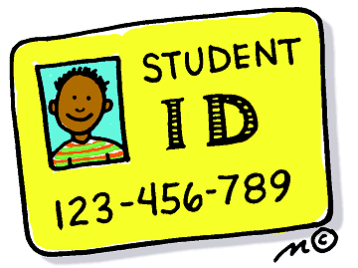
Q: How do I get a Library card?
A: Your MCC student ID card is your Library card. MCC ID cards are available at Student Services, although this may vary from campus to campus.
All current students, faculty, and staff are automatically added to the Library’s computer system each quarter.

Slide 5
Q: Are there fines for overdue Library materials?
A: MCC does not charge daily fines for overdue MCC library materials but if you don’t return them, you will be charged the full cost of the materials and have your student account blocked. Overdue interlibrary loan items could be assessed a $100 fine.
Note: Omaha Public Library materials do have a daily fine assessed to your library account.

Slide 6
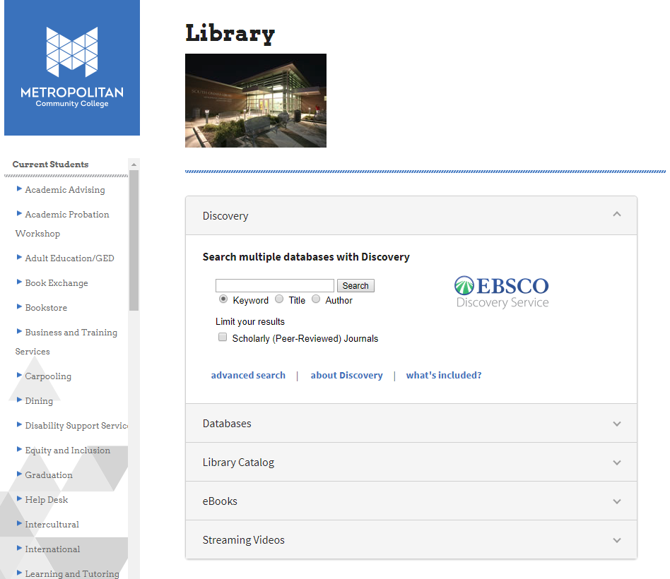
MCC LIBRARY

Slide 7
Search the Sierra catalog to locate items:
Keyword
Title
Journal title
Author
Subject
Campus location

Slide 8
Search Results:
Campus location
Call number
Availability
Subjects and keyword

Slide 9
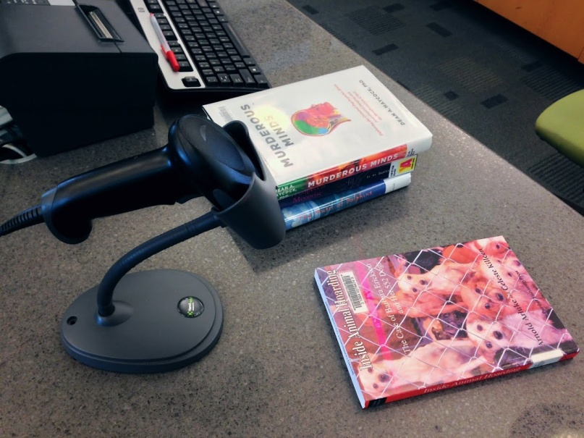
Q: How long can I check out materials?
A: Loan periods vary depending on the format. MCC books are 4 weeks while DVD’s, magazines and journals are 2 weeks.

Slide 10
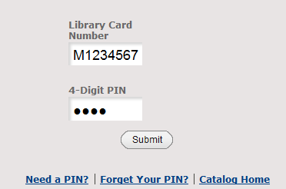
Q: How do I request an item from the library?
A: Log into the library catalog and search for the titles you want to place a hold on, then click “Request.” Use your MCC Student ID number, PIN number, and then select the library location for pickup.

Slide 11
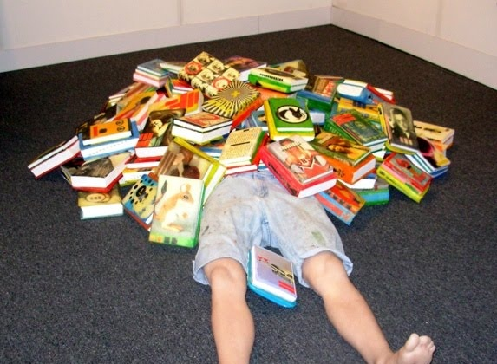
Q: Where do I return Library materials?
A: MCC or Omaha Public Library materials may be returned to any MCC campus library or Omaha Public Library location.

Slide 12
Q: Where can I search for online magazine, journal or newspaper articles?
A: The libraries subscribe to more than 50 online research databases containing citations, abstracts and full text articles from thousands of magazines, journals, and newspapers.

Slide 13
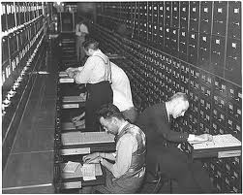
Q: What is a Database?
An electronic catalog or index
Contains information from published works
Databases often contain full text articles or abstracts
There are two types: general or specific
They are searchable

Slide 14
DATABASES

Slide 15
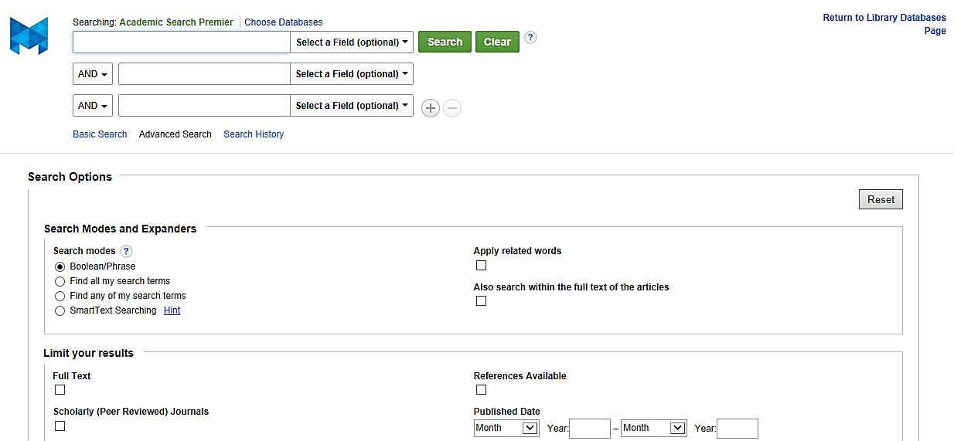
Academic Search Complete
Contains 9,000 journals, magazines, & newspapers; includes full text
Limit to scholarly/peer reviewed/year
Formatted citations
Print, save, or e-mail references and articles

Slide 16
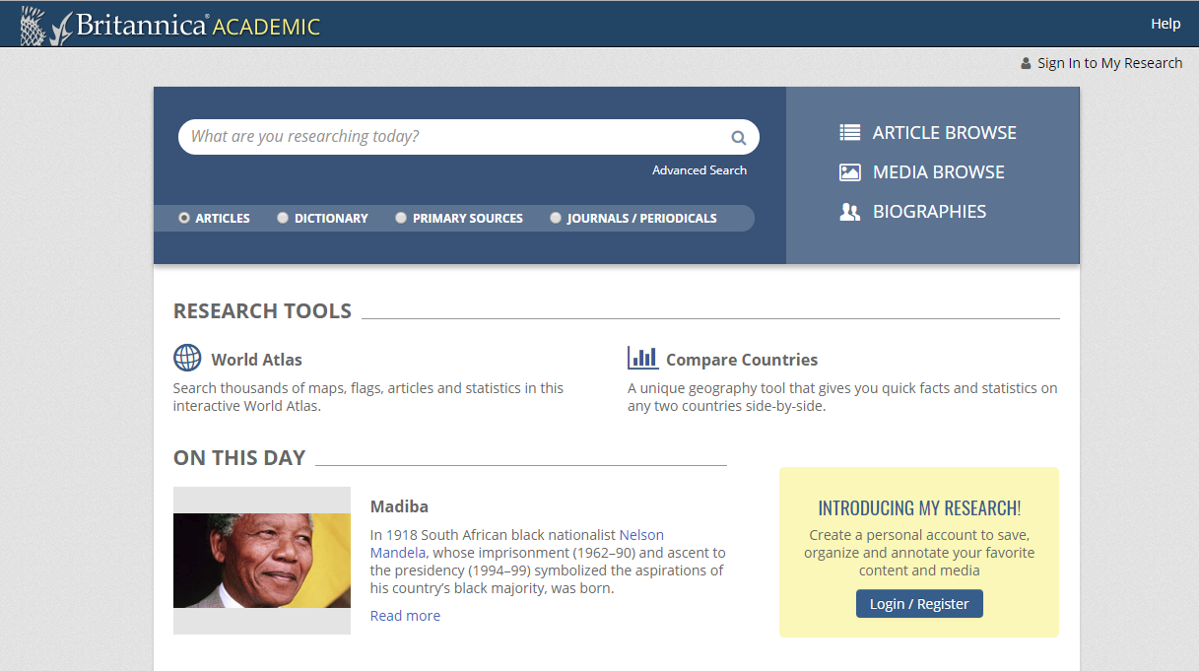
Britannica Academic
Full text multimedia encyclopedia updated every two weeks
Thousands of cross-referencing internet links
Coverage of current topics and news reports

Slide 17
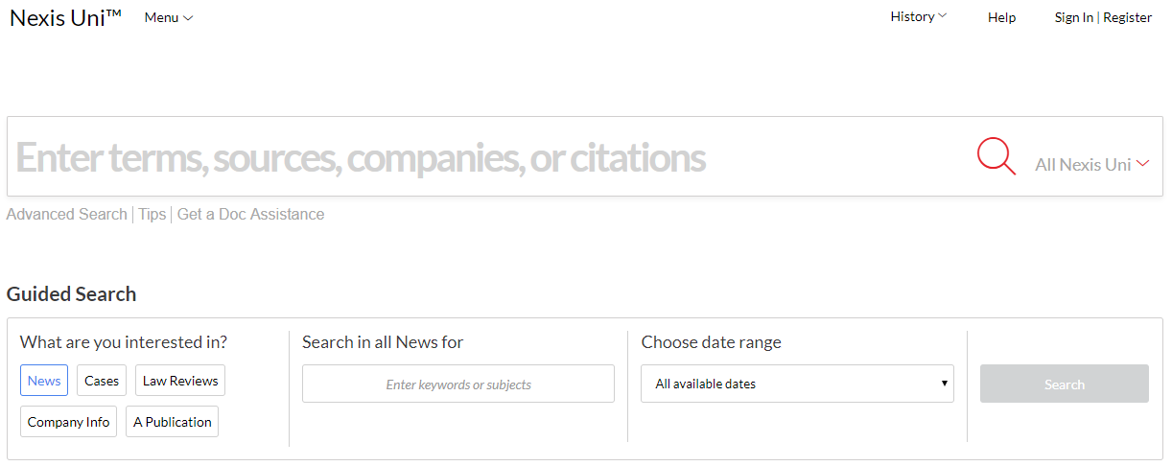
Nexis Uni
45,000 legal, business, and news sources
Federal and state legal cases
Company information
International and national newspapers

Slide 18
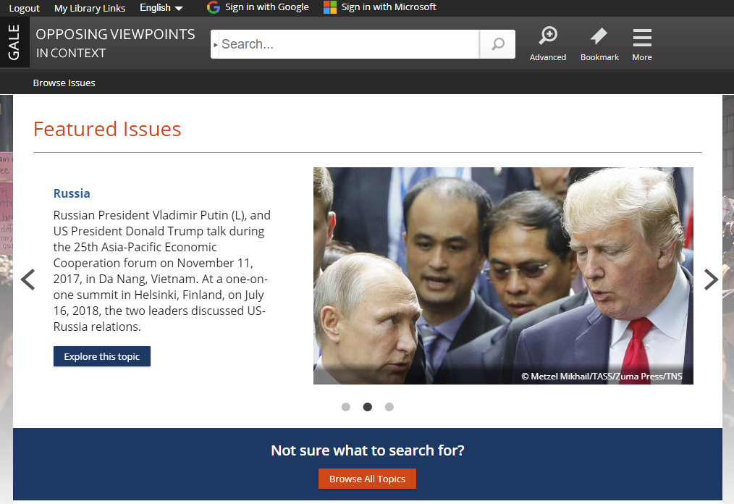
Opposing Viewpoints
Information about controversial issues
Articles, statistics, & videos
Updated daily news
Expert selected full text articles

Slide 19
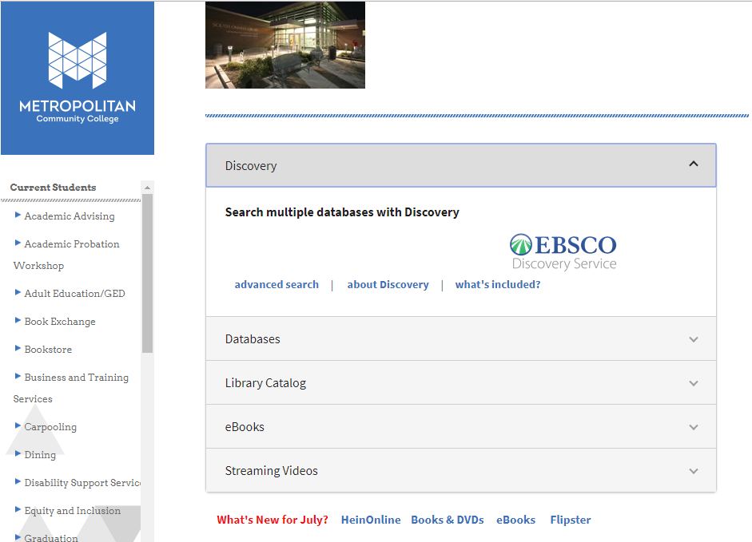
Discovery Tool
Simple access to the MCC Library’s resources
Search a broad range of materials types for research: journals, books, newspapers, periodicals, reference and more
Direct links into specific databases

Slide 20
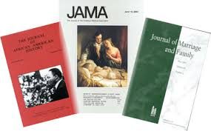
Q: How do I know if a specific magazine, newspaper or journal is available at MCC?
A: Go to the library webpage and click on “Magazines & Journals A-Z” (in the right menu). This is an alphabetical listing of all of the magazines, newspapers, and journals available in a campus library “print” or through an “electronic journal”

Slide 21
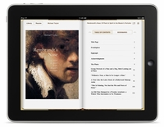
Q: Does the library have eBooks?
A: We have more than 40,000 eBooks on a variety of topics which are available to students, faculty and staff through our EBSCO eBook Collection. Patrons can access the full text of the eBooks from their computer or download titles to various mobile devices.

Slide 22
Q: How do I access library resources from off-campus?
A: Anyone can access the library webpage and the library catalog from any computer with Internet access. Access to the library databases is restricted to current MCC faculty, staff or students. You will login with your MCC username and password.

Slide 23
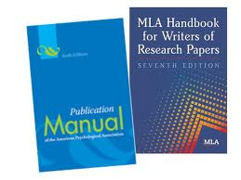
Q: How can I get help with citing sources?
A: Go to the library webpage and click on “Citing Sources” (in the right menu). This page has style guides, handouts, tutorials, and links to assist with citation styles.

Slide 24
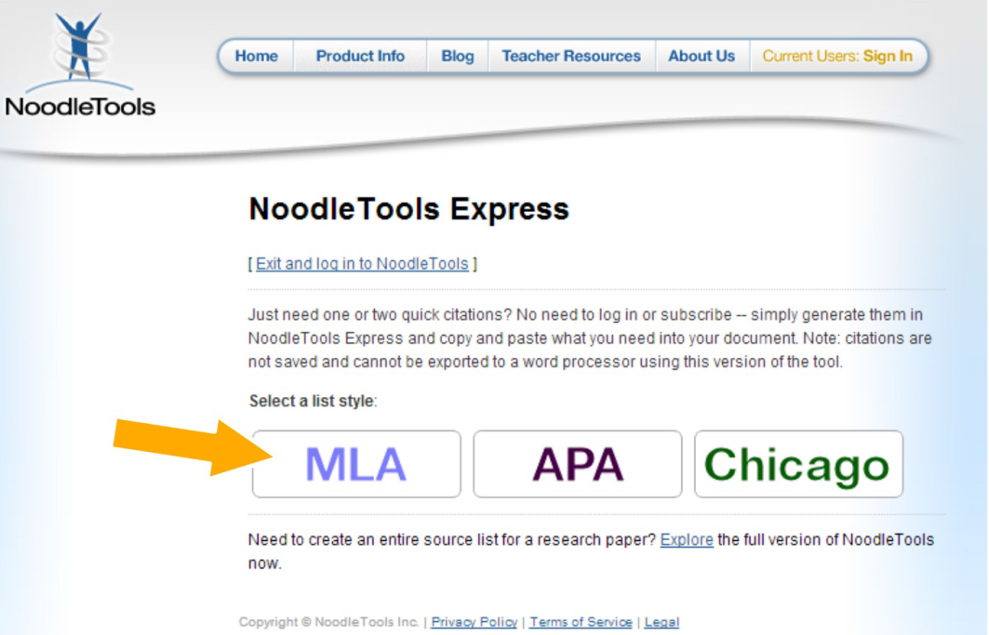
CITATION HELP
NoodleTools Express
Generates MLA, APA and Chicago citations
Provides step-by-step instructions
Fill in all the information about the source
Citations can be pasted to Microsoft Word

Slide 25
Q: What are the Library hours? Library Hours
Elkhorn Valley
Monday - Thursday:
7:30 a.m. - 10:00 p.m.
Friday:
7:30 a.m. - 5:00 p.m.
Saturday:
7:30 a.m. - 3:00 p.m.
Sunday: Closed
Fort Omaha
Monday - Thursday:
7:30 a.m. - 10:00 p.m.
Friday:
7:30 a.m. - 5:00 p.m.
Saturday:
8:00 a.m. - 4:00 p.m.
Sunday: Closed
South Omaha
Monday - Thursday:
7:30 a.m. - 9:00 p.m.
Friday:
9:00 a.m. - 6:00 p.m.
Saturday:
9:00 a.m. - 6:00 p.m.
Sunday: Closed

Slide 26
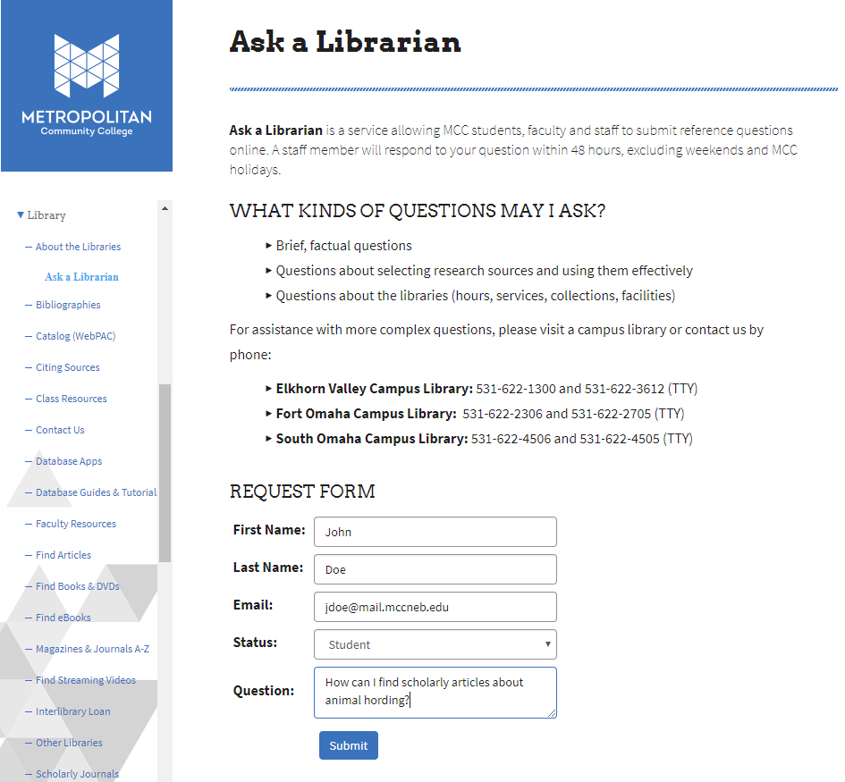
Questions?
Contact us anytime
Thank you!

